Slide 1
Pressurized Portable Marine Fuel Tanks
Mark Riechers

Slide 2
EPA Regulation §(1060.105 (c))
effective 01 Jan 2010
(c) Portable marine fuel tanks and associated fuel-system components must meet the following requirements:
(1) They must be self-sealing (without any manual vents) when not attached to the engines. The tanks may not vent to the atmosphere when attached to an engine.
(2) They must remain sealed up to a positive pressure of 34.5 kPa (5.0 psig); however, they may contain air inlets that open when there is a vacuum pressure inside the tank.

Slide 3
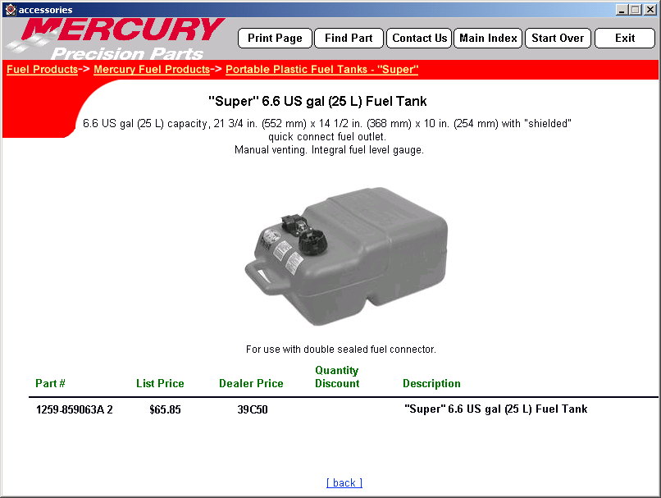
Portable Tank Design Changes
Current Design
EPA Regulation §(1060.105 (c))
-2kPa
35kPa

Slide 4

Diurnal Pump Intake
Cool air
F_{R}
F_{R}
F_{R}
Wall of tank provides reactionary force to draw volume into the tank.
(Tank wall is functioning as a pump diaphragm/spring)

Slide 5

Diurnal Pump Exhaust
If hose or engine leak… Pumping Cycle Continues until tank is empty
F_{R}
F_{R}
F_{R}
Wall of tank provides reactionary force to expel liquid from tank.
(Tank wall is functioning as a pump diaphragm/spring)

Slide 6
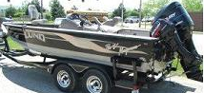
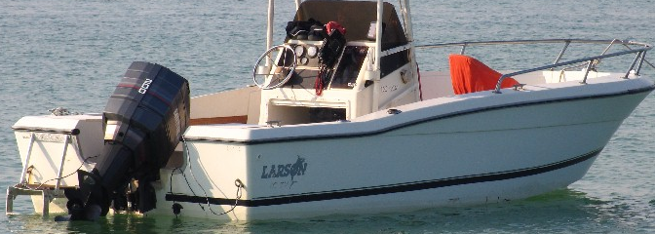
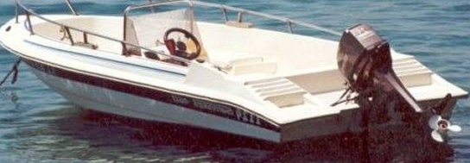
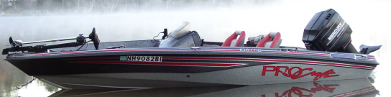
Tilted Engine Applications

Slide 7
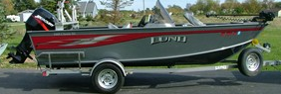
Dynamic “Trailering” Overflow Test
Determine Maximum Dynamic Inlet Pressure
Ref. Vapor Separator (Optimax)
Position test unit at 70° tilt and 30° turn.
Route clear vent hose to container for overflow capture
Fill float bowl completely full (overflow into vent hose)
Accelerate assembly per respective value above
Apply pressure, monitor overflow for “pop-off” value
Combined
Tilt and Turn
Worst-Case
Turn

Slide 8
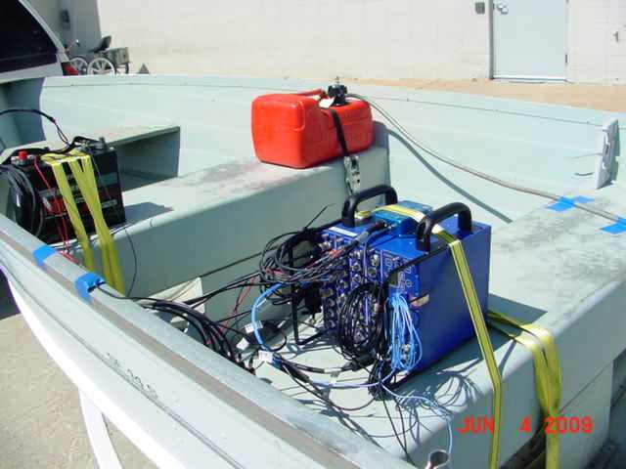
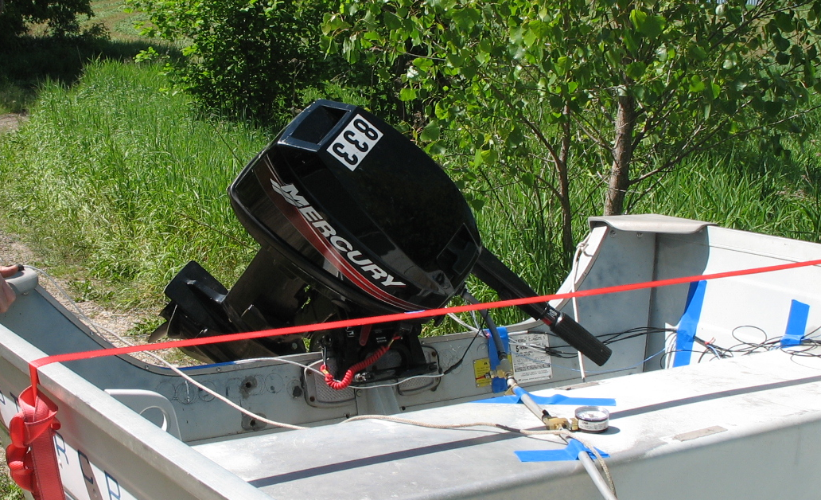
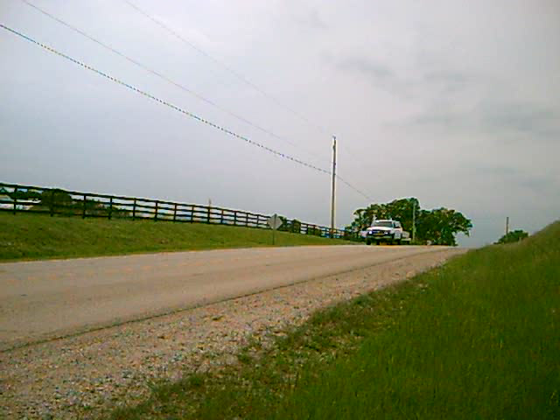
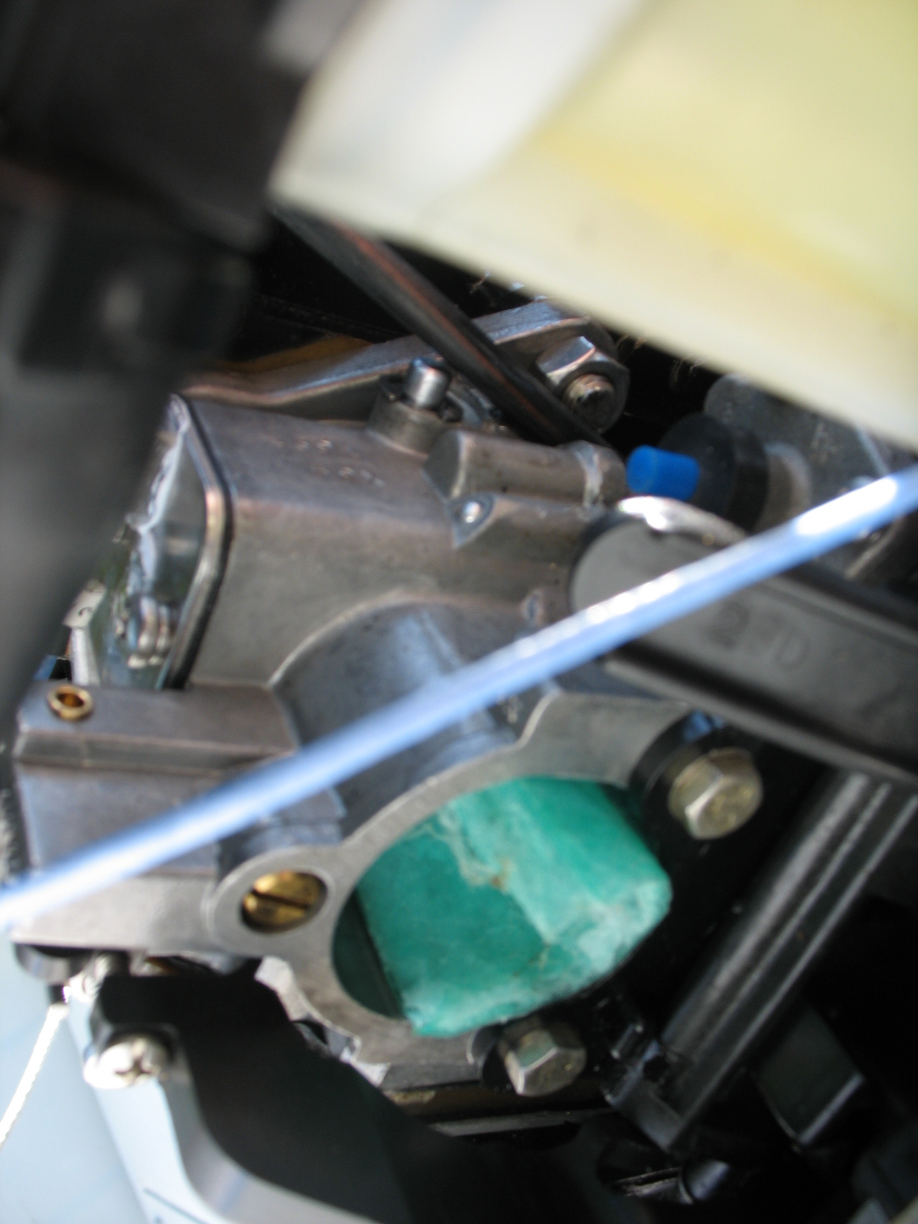
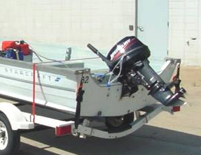
Rough Road Testing

Slide 9
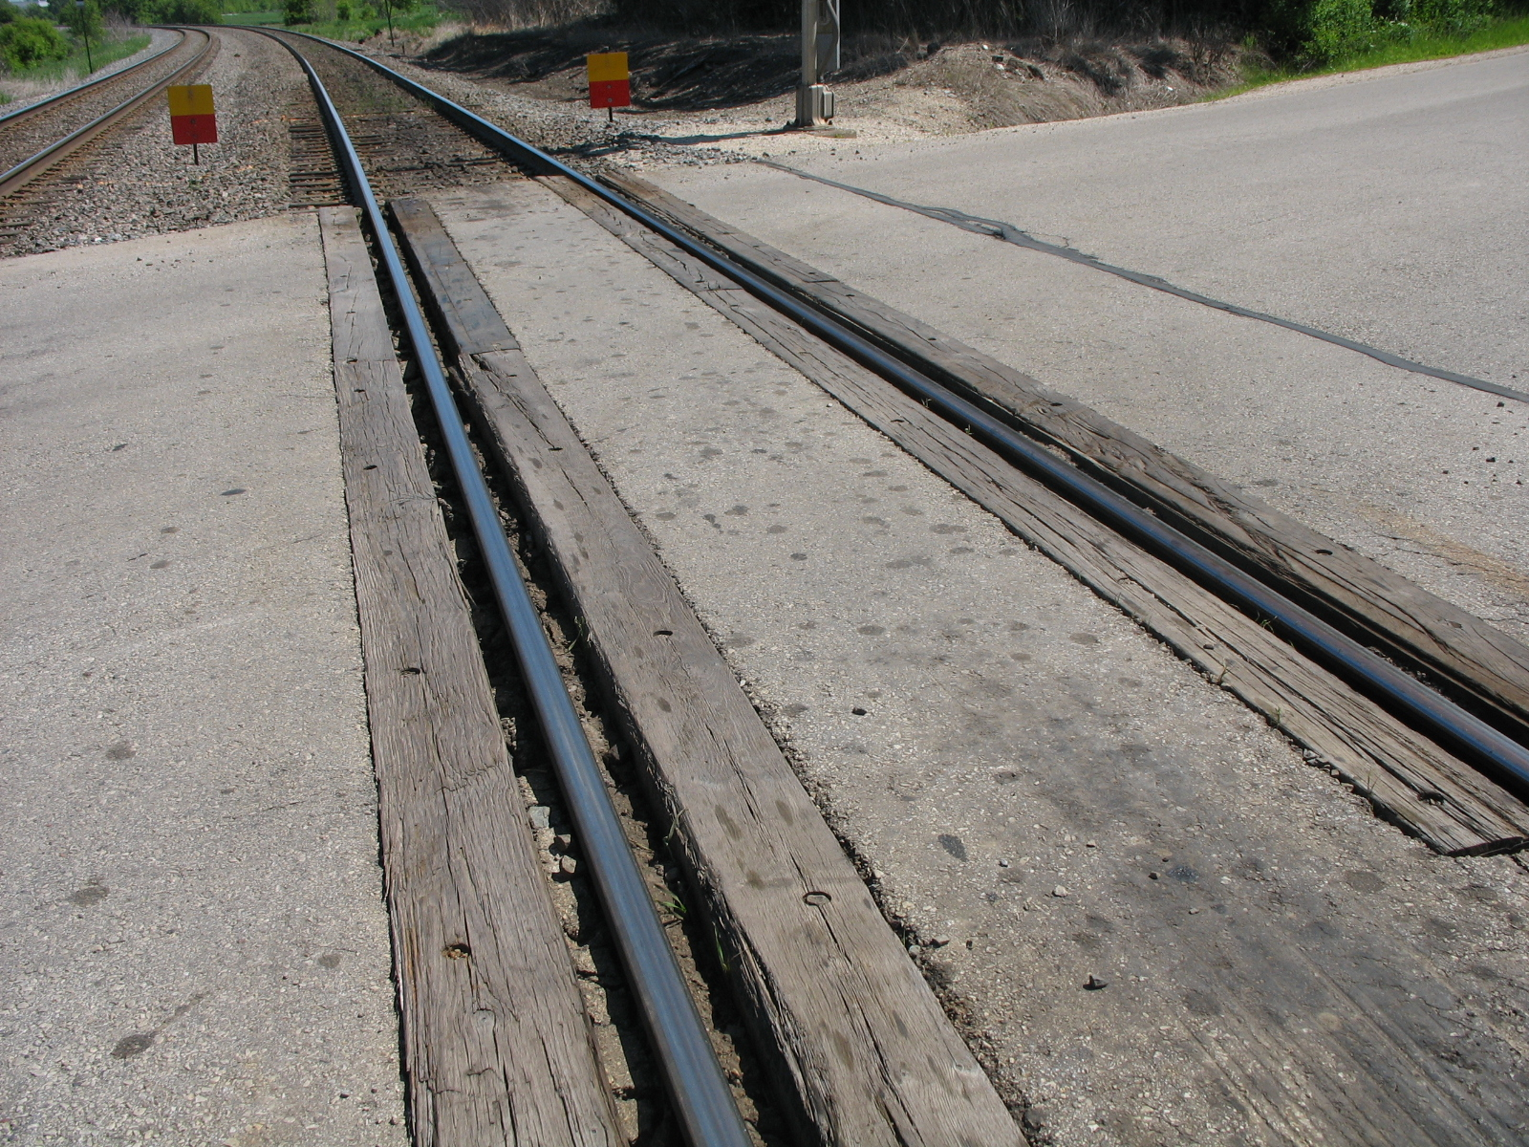
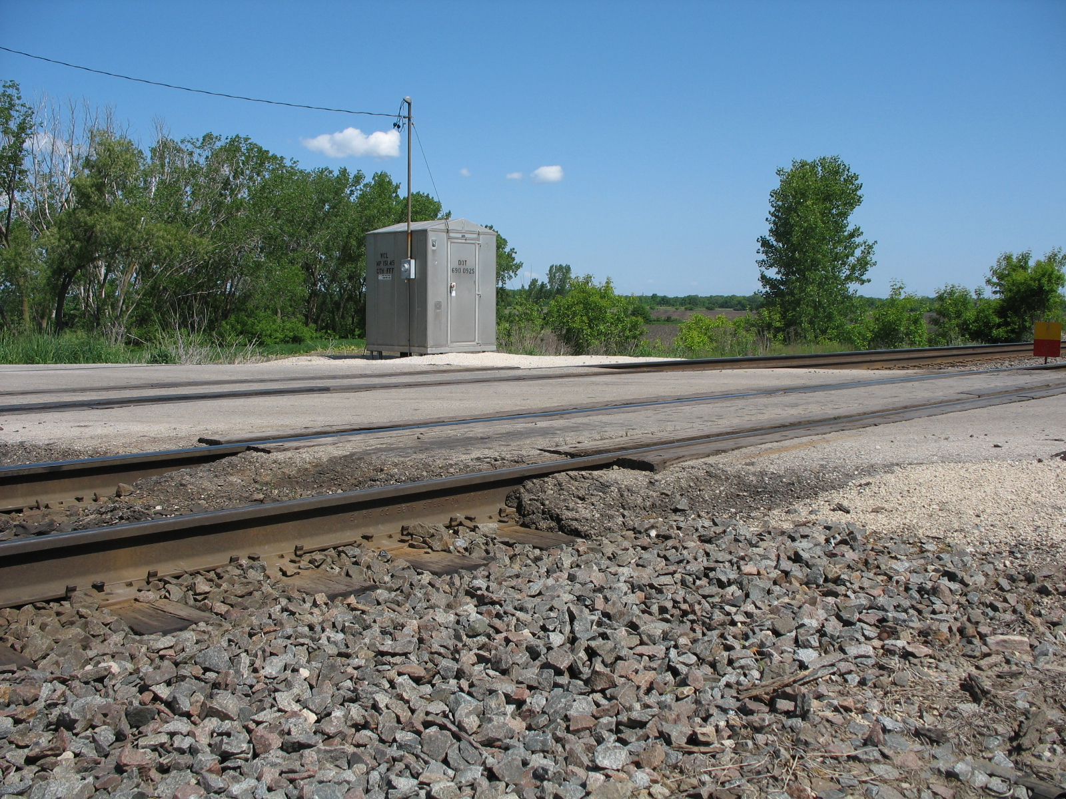
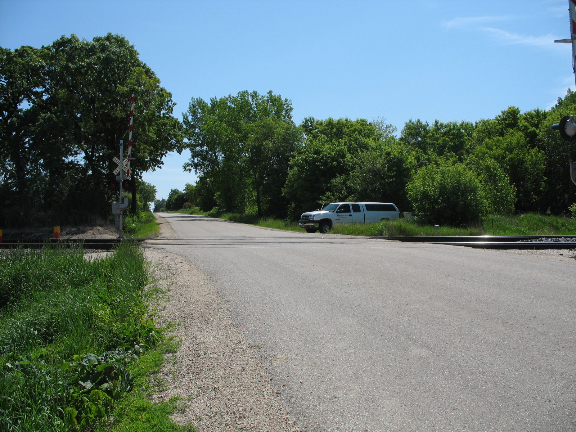
Rough Road Results
Transom Vertical Motion Time History, 25 MPH, RR XING

Slide 10
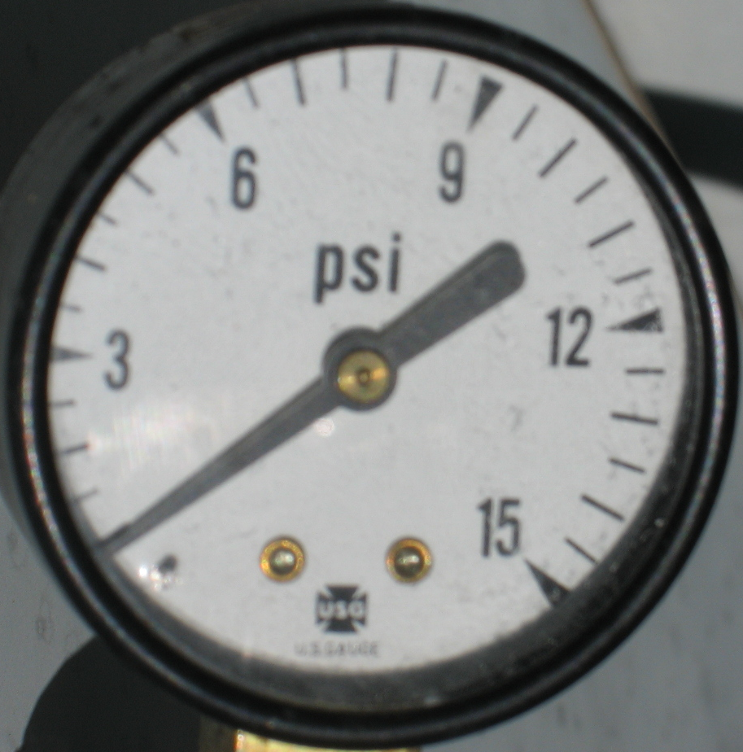
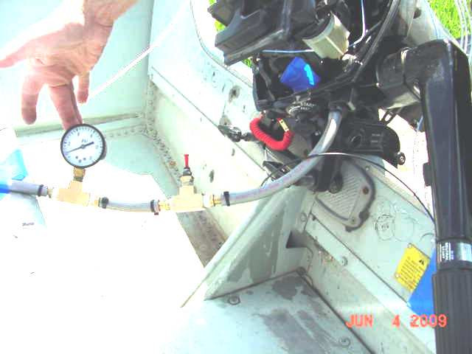
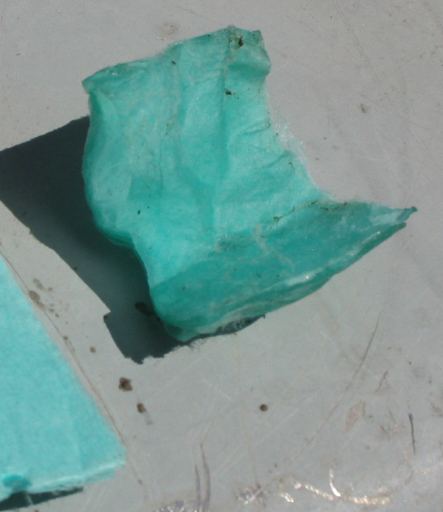
Rough Road Conclusions
100 mm of transom displacement
Visible Leakage from Carburetor at 7kPa (1psi)
Portable Fuel Tank

